Slide 1
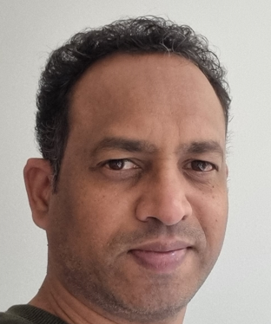
Tushar Meshram Associate Manager AMBG- Technology (+49) - 15140271605 Tushar.u.meshram@accenture.com
Areas of Experience
DevOps Tools
Docker, Azure DevOps, VSTS, SonarQube, Azure
YAML, PowerShell, Shell Scripting, TFS, Jenkins, Git, SVN, Akamai, Ant, Maven, Nginx, Apache, Tomcat, Jboss, Navision, Nexus, UCD, Python( Basic), Bicep (Basic), Kubernetes
Worked on : Azure ETL Tools ( DataFactory, DataBricks, LogicApps, FunctionApps )
Professional Background
Certification
.
DevOps Engineer Expert
Azure AI Fundamentals AI-900
Versatile IT professional with extensive leadership and technical skills, hands-on experience, automating and optimizing mission critical deployments in various DevOps tools, leveraging configuration management and DevOps principles. Proven ability to work with cross-functional teams. Exemplary communication skills and a strong engineering professional with a Master of Science (M.Sc.) focused in Computer Science. Have showcased and handled the clients individually and implemented the enhancements in the existing process. Having vast experience in setting up the build and deployment environments from Dev to Production from scratch. Implementation of automation using scripting to perform the CI/CD pipeline using various DevOps tools.
Selected Relevant Experience
Products
Project Migration from AWS ( EKS ) to AKS
Automated Azure pipelines
Oil and Gas Domain project
Defined, Implemented the DevOps tools and best practice strategy in the project.
Environment creation using Docker, Shell scripting, setting up MongoDB, Redis and Nginx as webservice on QA and production.
Went live successfully on the created environment from scratch.
Consultant to Banking firm project:
Streamlined the project as per the best DevOps practices.
Implementation of automation, CI/CD pipeline, Monitoring, Code Analysis.
Configuration Management lead
Leading the engagement to bring project from onsite
Define the Overall DevOps implementation across multiple projects.
Defining the branching and deployment strategy.
Key Experience
Project Manager for the Azure Disaster Recovery enablement. ( Azure Resources )
Have implemented two projects within Accenture from scratch. Implementation includes defining of overall flow of DevOps, Branching Strategy, Deployment cycle and environment setup.
Migration of EKS to AKS
Environment setup from Dev to Production includes Docker, Automation, Redis and MongoDB configuration, Dynatrace for monitoring, installation of certificates with respect to project on the servers. It also incudes defining the branching and CI/CD pipeline to get it work seamlessly across environments.
Implemented successful installation of TFS 2013 / 2015 by defining the ALM flow.
Configuration of CI/CD in TFS using XAML definition and Release Management Module and later migrated to VSTS builds. A challenge of migration of TFVC to Git been successfully implemented.

